Slide 1


DAYANANDA SAGAR UNIVERSITY
SCHOOL OF ENGINEERING
Computer Science and Engineering (AIML)
Email Classification System Using NLP
Under the Supervision
Prof. Pradeep Kumar
Presented By:
Amar H M (ENG23AM1001)

Slide 2
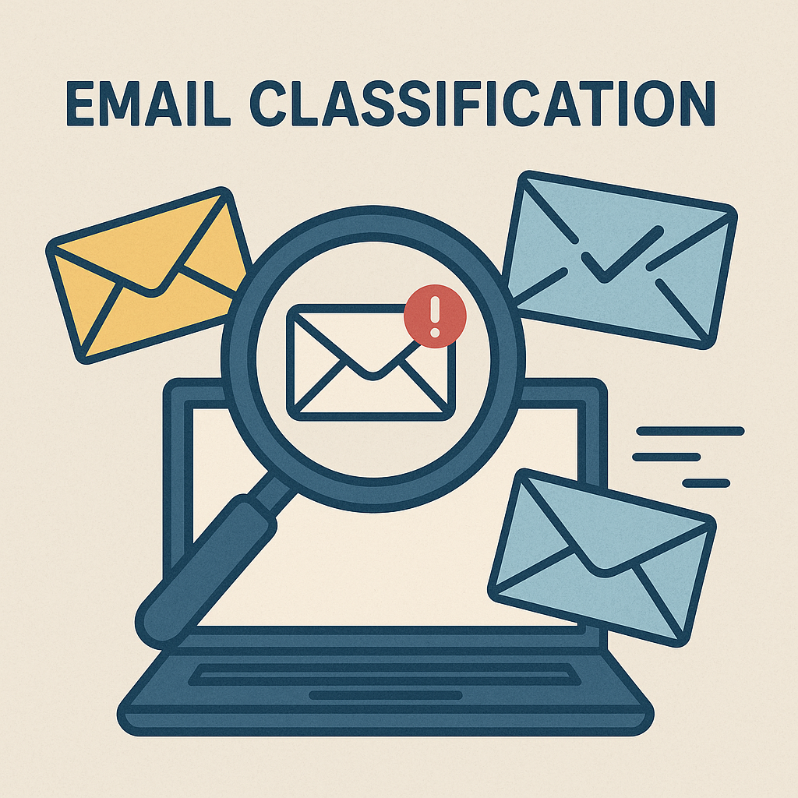
INTRODUCTION
Email communication is an integral part of modern personal and professional life.
With the rising number of emails, manual sorting becomes time-consuming and inefficient.
Email classification helps organize emails into categories like:
Spam
Queries
Feedback
Notifications, etc.
Our project uses Natural Language Processing (NLP) to analyze email content.
Machine Learning (ML) is used to train a model that can automatically classify emails.
Real-time email fetching is done using the IMAP protocol.
The system provides fast, accurate, and scalable email categorization.

Slide 3
OBJECTIVES
Develop an intelligent system to classify incoming emails automatically.
Preprocess email content by combining subject and body for analysis.
Use Natural Language Processing (NLP) to extract meaningful text features.
Train a Machine Learning model to accurately categorize emails into predefined classes.
Fetch real-time emails using the IMAP protocol securely.
Test and validate the system on real email data to ensure reliability.
Export classification results into a structured CSV report for record-keeping.
Provide a scalable solution that can be extended for enterprise-level email management.

Slide 4
TOOLS & TECHNOLOGIES USED
Programming Language: Python
Data Handling: pandas
Machine Learning:
scikit-learn – For model training and TF-IDF vectorization
MultinomialNB – Naive Bayes classifier
NLP:
TfidfVectorizer – To extract features from text
Stop words removal – English stop words filtered
Email Handling:
imapclient – For IMAP protocol and fetching emails
pyzmail – For parsing and reading email content
Output: CSV report generated using pandas

Slide 5
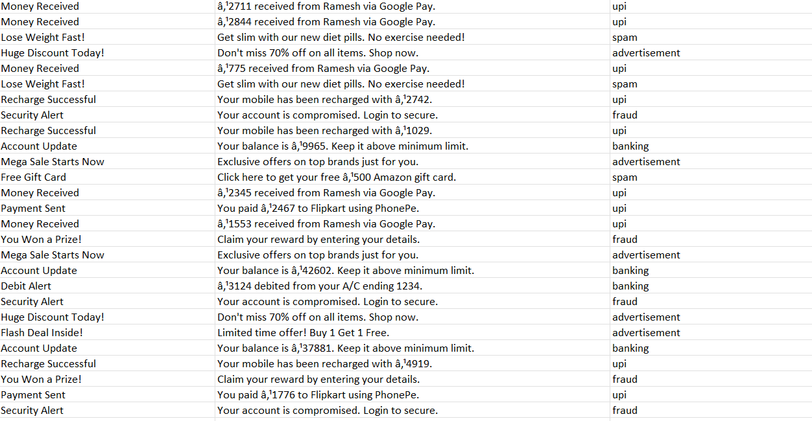
DATASET OVERVIEW
Dataset: email_classification_dataset_1M.csv
Size: ~1 Million emails
Fields Used: Subject, Body, Category
Preprocessing:
Removed missing entries
Combined subject and body into a single text field
Categories: Spam, Queries, Feedback, etc.
Format: CSV, processed using pandas

Slide 6
METHODOLOGY
Data Loading: Imported dataset using pandas
Preprocessing:
Dropped null values
Merged subject and body for text analysis
Feature Extraction:
Used TF-IDF Vectorizer to convert text into numerical features
Limited to top 5000 features to reduce complexity
Model Training:
Applied Multinomial Naive Bayes classifier
Trained model on labeled data
Email Fetching:
Accessed real-time emails using IMAP protocol via imapclient
Parsed email content using pyzmail
Prediction & Output:
Classified emails with a confidence threshold
Saved results to a CSV file

Slide 7
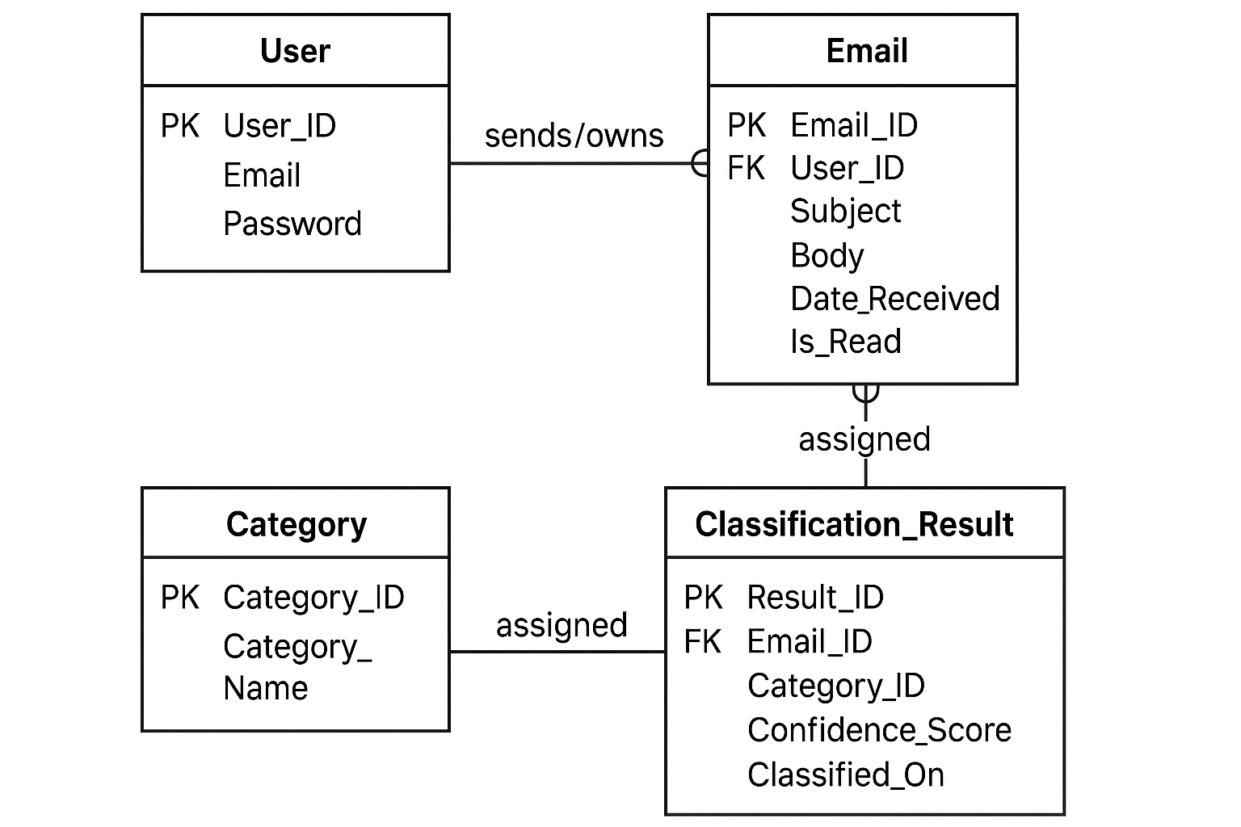
ER Diagram

Slide 8
ADVANTAGES
Automatically classifies large volumes of emails efficiently
Uses NLP and ML for accurate and intelligent categorization
Saves time by reducing manual sorting
Can process real-time emails using IMAP
Exports results for easy tracking and reporting

Slide 9
Limitations
Accuracy depends on the quality and balance of training data
May misclassify emails with unclear or minimal text
Requires secure handling of email credentials
Needs internet access for real-time email fetching
Performance may degrade with very large datasets without optimization

Slide 10
RESULTS
Model Accuracy: Achieved approximately [Insert Accuracy]% accuracy on the training dataset, demonstrating strong classification ability.
Generalization: Effectively handles unseen emails with reliable predictions.
Confidence Scores: Provides confidence levels for each classification, helping assess prediction reliability.
Performance: Fast processing on structured text data using classical ML methods, ensuring scalability for large datasets.
Real-Time Capability: Successfully integrated with IMAP to classify emails as they arrive, enabling practical use.

Slide 11
FUTURE ENHANCEMENTS
Incorporate Deep Learning Models: Upgrade to advanced NLP models like BERT or LSTM to improve classification accuracy and handle complex language patterns.
Develop a User-Friendly GUI: Build an intuitive graphical interface to allow users to easily manage, view, and interact with classified emails.
Support Multi-Label Classification: Enable the system to assign multiple categories to emails that belong to more than one class (e.g., spam + promotion).
Integrate with Corporate Email Servers: Extend support for enterprise-level email platforms to enhance scalability and real-world applicability.
Enhance Security Measures: Implement secure authentication methods beyond app passwords, ensuring compliance with modern security standards.

Slide 12
Conclusion
Developed an efficient and reliable system for automatic email classification using tried-and-tested NLP and Machine Learning techniques.
Demonstrated practical application of AI to improve daily communication management.
Showcased the power of combining classical methods (like Naive Bayes) with modern data processing for real-time solutions.
The system lays a strong foundation for enterprise-level extensions and deeper AI integration in the future.
This project reflects the timeless value of building robust, maintainable systems grounded in proven methodologies while paving the way for innovation.

Slide 13
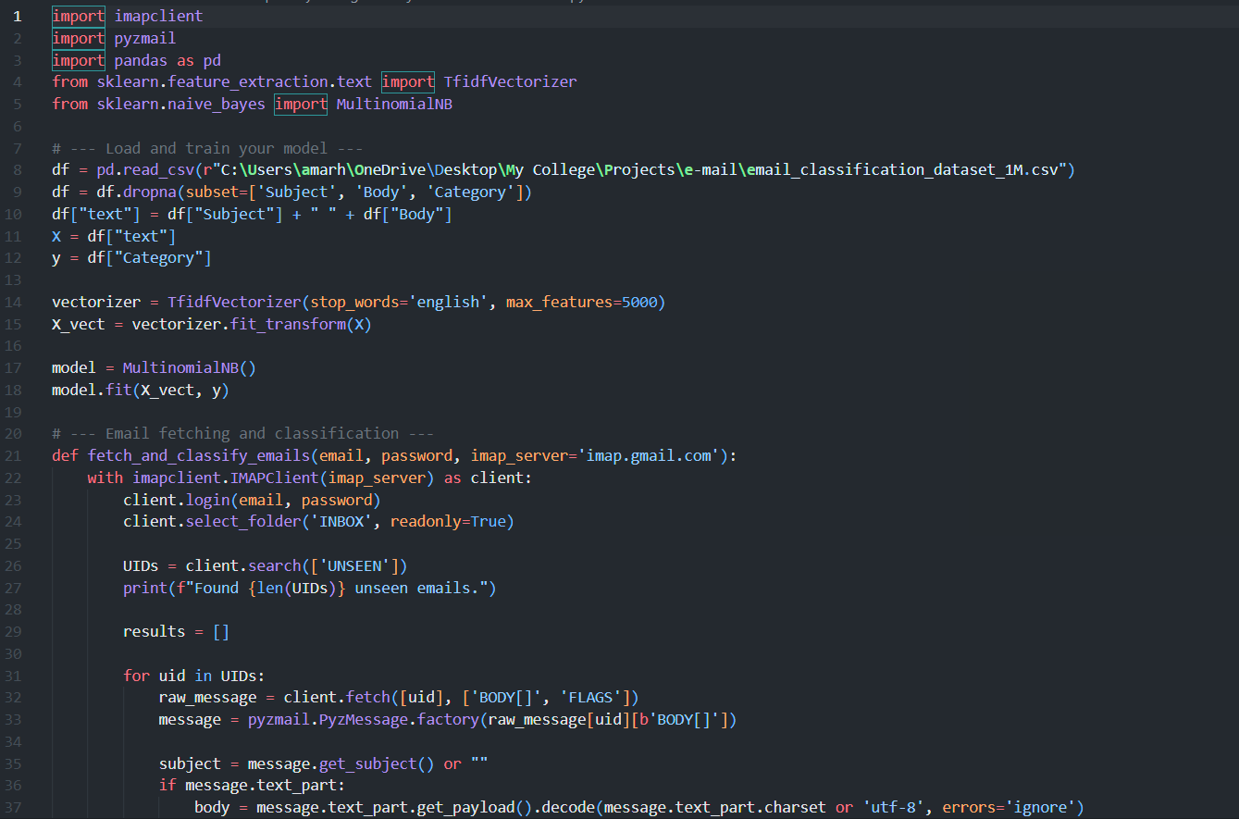
CODE -

Slide 14
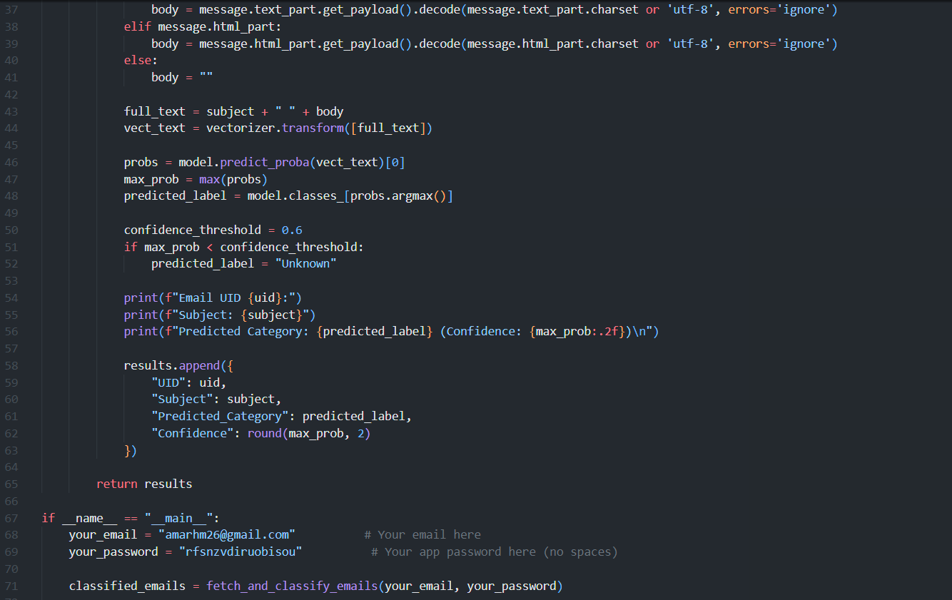
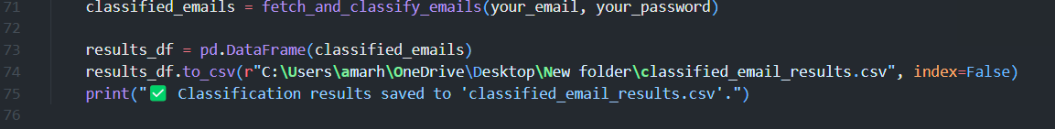

Slide 15
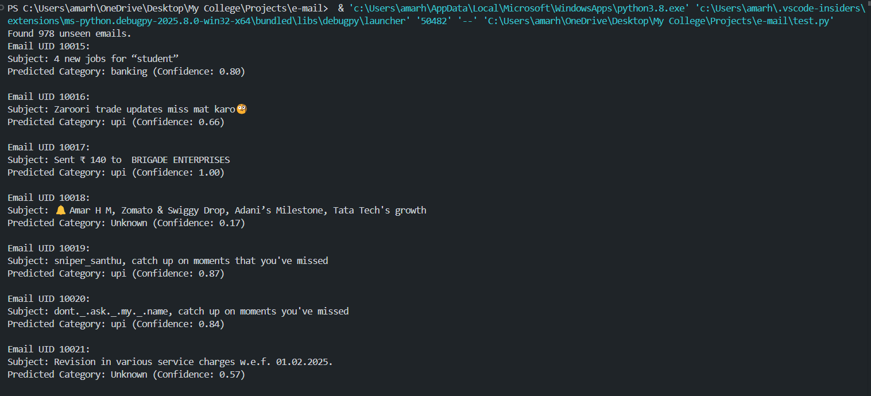
OUT PUT -

Slide 16
DATA SETS -

Slide 17
THANK
YOU

